Slide 1

Fundamentals of Data Science
www.BigDataTrunk.com

Slide 2
Welcome to
Fundamentals of Data Science
PRE-WORK
Sign-in for Attendance
Put Name on Name tag
Download Anaconda (python v3.x)
https://www.anaconda.com/distribution/
Download files: tinyurl.com/y5fqrhzp
www.BigDataTrunk.com

Slide 3
Introduction
Antony Ross
Data Science and Machine Learning
Sports performance data
Research in music recommendations and voice recognition

Slide 4
Agenda
01
Data Science Overview
02
Data Analytics vs. DS
03
Descriptive Statistics
04
The Data Science Process
05
Python Libraries for DS
06
Next Steps

Slide 5
Logistics
Timing – 9 to 4 PM PST
Lunch – Approx. noon to 1 PM PST
Periodic Breaks – At logical points

Slide 6
Data Analytics vs. Data Science

Slide 7
Hands-on
Jupyter Notebook & Python

Slide 8
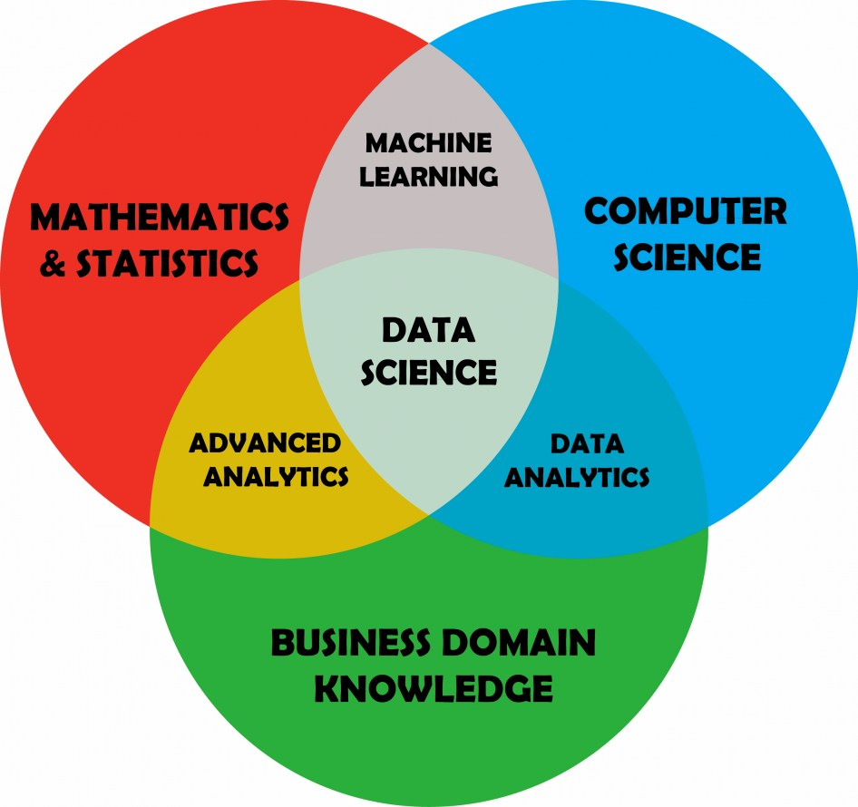
Data Science

Slide 9
Descriptive Statistics

Slide 10
The Data Science Process (DIAPERS)
Define Problem Statement
Ingest Data
Analyze Data
Prepare Data for ML
Evaluate Models
Refine Model
Ship It

Slide 11
Define Problem Statement

Slide 12
Ask good questions:
answerable
actionable
specific
narrow

Slide 13
Ingest Data

Slide 14
Google Dataset Search
toolbox.google.com/datasetsearch
Kaggle
kaggle.com/datasets
ProPublica Data Store
propublica.org/datastore
World Bank Open Data
data.worldbank.org

Slide 15
Some challenges with data
Insufficient quantity of data
Non-representative data
Poor quality of data
Irrelevant features

Slide 16
Analyze Data

Slide 17
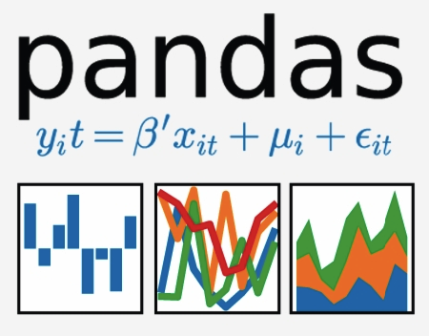

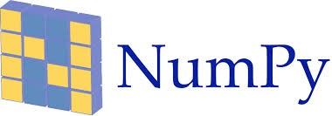


Python Libraries for Data Analysis

Slide 18
Prepare Data

Slide 19
Prepare Data

Slide 20
Pandas
Hands-on Lab
Pandas Exercise

Slide 21
Exploratory Data Analysis

Slide 22
Process Walk-through

Slide 23
Survey Time
http://ttseval.stanford.edu

Slide 24
Machine Learning Model

Slide 25
Scikit-learn
Hands-on Lab
Scikit-learn Exercise

Slide 26
Next steps
Make a custom plan for yourself to continue this journey
Improve some of your skills (Stats, Python, ML, Domain, etc.)
Take some additional courses
Try a Kaggle.com competition
Work on a personal project to improve understanding

Slide 27
Useful Data Science and Machine Learning books for beginners to intermediate:
Book | Author
Data Smart: Using Data Science to Transform Information Into Insight | John W. Foreman
Naked Statistics: Stripping the Dread from the Data | Charles Wheelan
An Introduction to Statistical Learning | Robert Tibshirani and Trevor Hastie
Python Machine Learning | Sebastian Raschka and Vahid Mirjalili
The Hundred-Page Machine Learning Book | Andriy Burkov

Slide 28
Stanford Upcoming Training
Click here for latest schedule

Slide 29
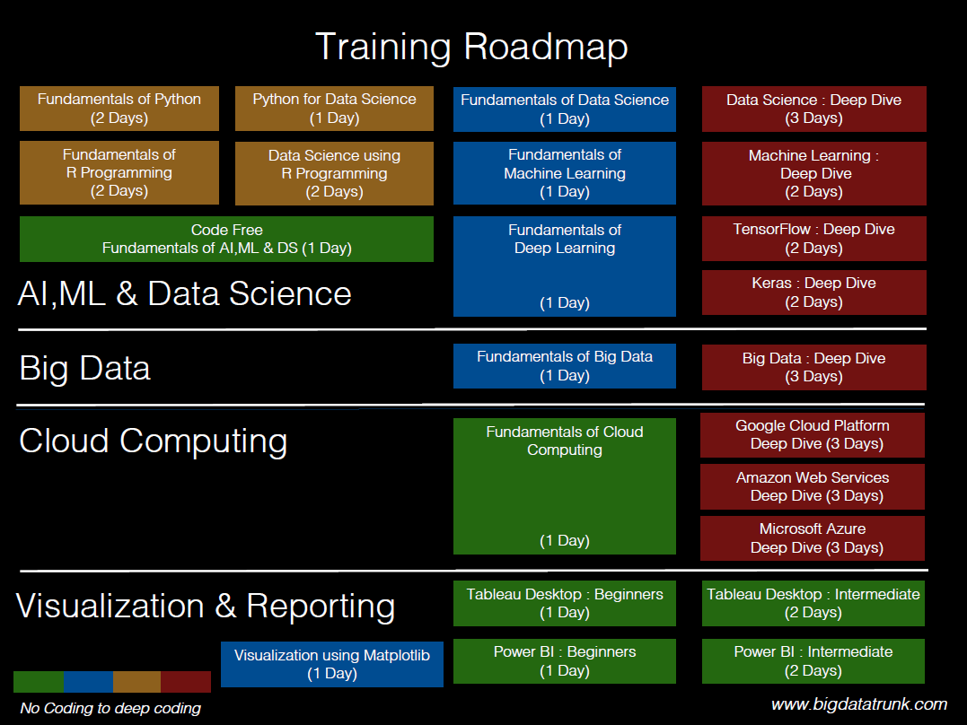

Slide 30
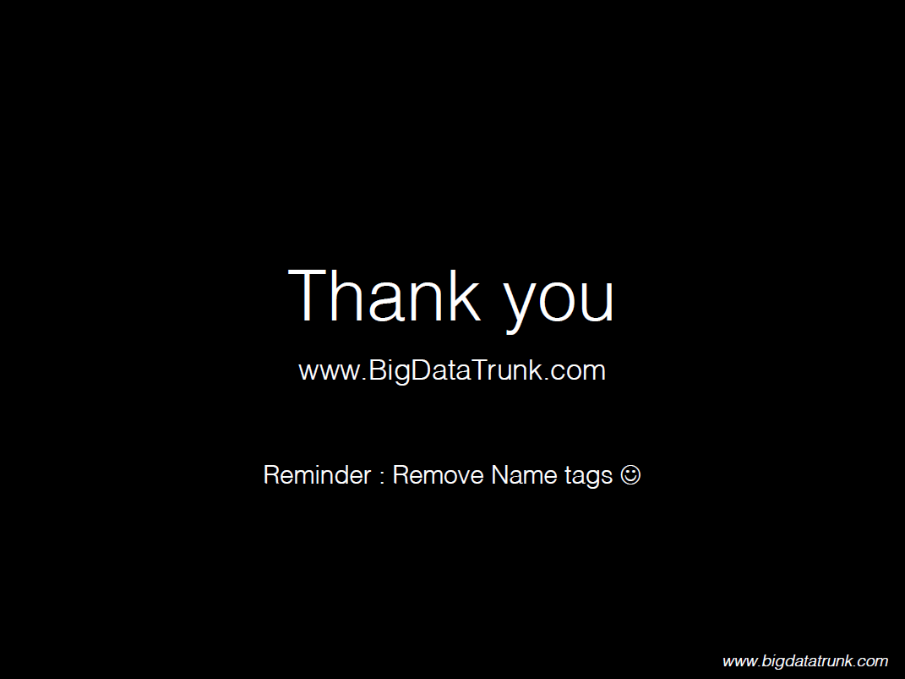

Slide 31
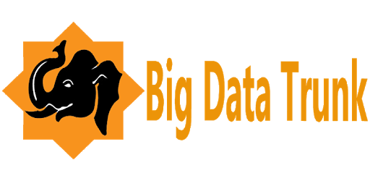

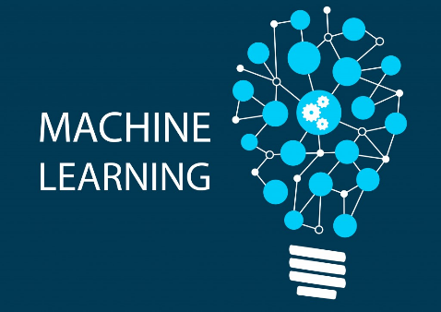

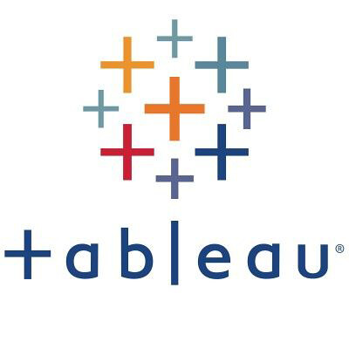


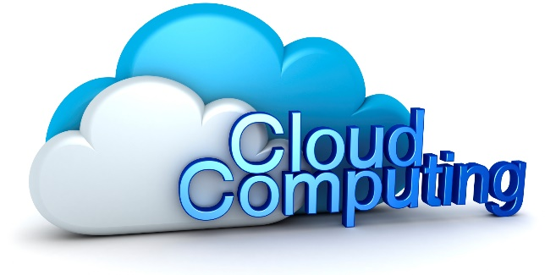

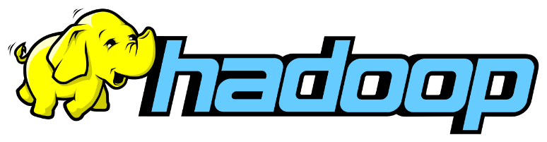

Stanford &

Slide 32
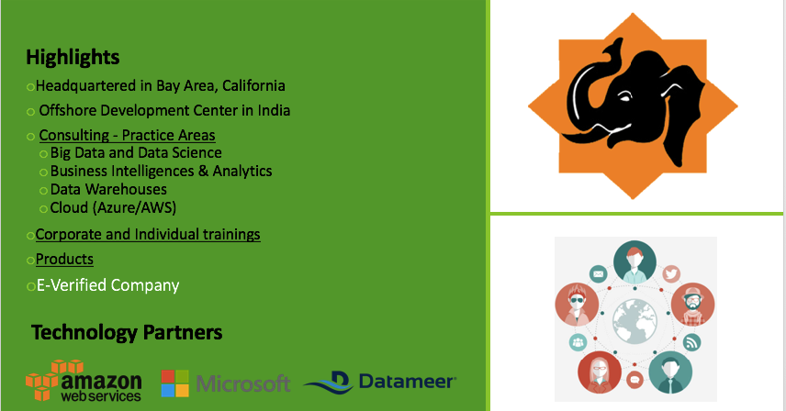
Big Data Trunk

